Slide 1
AI-Powered Code Generation Using CodeLlama

Slide 2
Introduction
In today's fast-paced software development environment, AI-powered tools are transforming the way developers write and optimize code. **CodeLlama**,an advanced large language model (LLM) developed by Meta, is specifically designed for code generation, auto-completion, and intelligent suggestions across various programming languages. With its deep understanding of syntax, patterns, and best practices, CodeLlama enhances coding efficiency, reduces errors, and accelerates the development process. This AI-powered system integrates **CodeLlama** with an intuitive interface, allowing developers to generate high-quality code in real time. Whether assisting with writingnew functions, refactoring existing code, or debugging errors, CodeLlama provides smart recommendations tailored to the developer’s needs. By leveraging the power of machine learning, this system can be deployed as a **web application, API service, or IDE plugin**,making it a versatile and scalable solution for modern software development.
Notes:
Image source: https://www.slidemake.com

Slide 3
ABSTRACT
The rapid evolution of artificial intelligence (AI) has significantly impacted software development, enabling automation and optimization ofcoding tasks. **CodeLlama**, a state-of-the-art large language model (LLM) developed by Meta, is specifically designed for code generation, auto-completion,and debugging across multiple programming languages. This project explores the
integration of CodeLlama into an AI-powered code generation system that assists developers in writing, optimizing, and debugging code efficiently. The system leverages **natural language processing (NLP) and deep learning** to understand user prompts and generate accurate, high-quality code snippets in real time. It can be deployed as a **web-based application, API service, or IDE plugin**, providing a seamless and scalable solution for developers. By reducing manual coding effort, improving code quality, and enhancing productivity,this AI-driven approach revolutionizes the software development process.The study also highlights the challenges of integrating AI into coding workflows, including security, performance optimization, and ethical considerations.
Notes:
Image source: https://i.ytimg.com

Slide 4
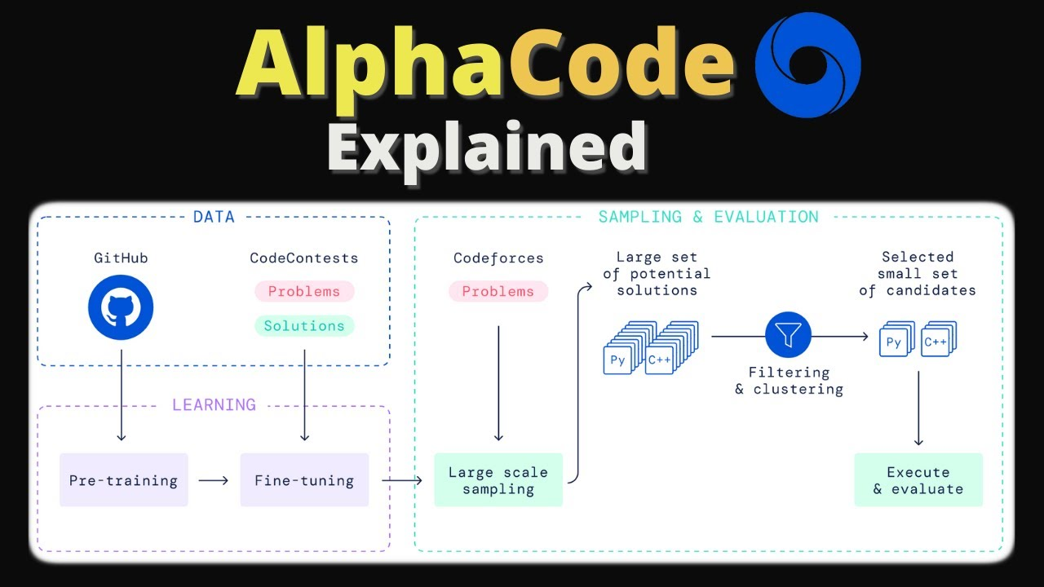
Key Features of CodeLlama
CodeLlama offers real-time code suggestions that adapt to the developer's coding style.
It supports multiple programming languages, making it versatile for various projects.
The tool can also assist in debugging by identifying potential errors and suggesting fixes.
Notes:
Image source: https://i.ytimg.com

Slide 5
Benefits of Using CodeLlama
CodeLlama significantly speeds up the coding process, allowing developers to focus on design and logic.
It reduces the learning curve for new programming languages by providing instant assistance.
The tool enhances collaboration by allowing teams to share and refine code more easily.
Notes:
Image source: https://www.slidemake.com

Slide 6
Workflow
User Input: Accepts prompts via CLI or web.
2.Preprocessing: Cleans and formats the input for CodeLlama.
3.Code Generation: AI model generates the required code.
4.Explanation Module: Provides insights into the generated code.
5.Debugging Module: Detects errors and suggests fixes.
6.Output Display: Returns code, explanations, and debug suggestions.

Slide 7
IMPLEMENTATION PROCESS
User Input
A user provides a natural language prompt (e.g., "Write a Python function to calculate Fibonacci numbers").
Preprocessing & Model Processing
The input is formatted and passed to the CodeLlama model.
The model generates code based on learned programming patterns.
Post-Processing & Explanation
The system refines the generated code.
A detailed explanation of the code is generated.
Debugging & Optimization
The debugging module scans the code for potential errors.
Suggestions for improvements are provided.
Output Display
The final code is displayed to the user.
Users can refine, edit, and regenerate the code as needed.

Slide 8
Key Features
✅ Real-time Code Generation – AI generates code snippets based on user descriptions.
✅ Multi-Language Support – Supports Python, JavaScript, Java, C++, and more.
✅ Auto-Completion & Optimization – Improves code structure and efficiency.
✅ Debugging Assistance – Identifies and suggests fixes for code errors.
✅ Interactive Learning – Provides explanations for generated code.
✅ Secure API Authentication – Ensures user data privacy with API key-based access.

Slide 9

Conclusion
CodeLlama represents a significant advancement in AI-powered code generation technologies.
By combining machine learning with coding practices, it enhances productivity and efficiency.
Embracing tools like CodeLlama can lead to a more innovative and responsive software development landscape.
Feel free to expand on any of these points or modify the content according to your specific needs!
Notes:
Image source: https://aitechtrend.com

